Slide 1
Section 7.3 Graphing Hyperbolas

Slide 2
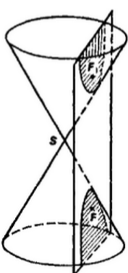
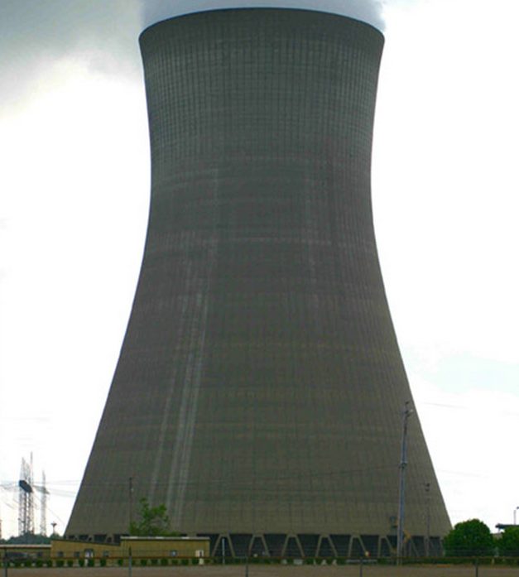
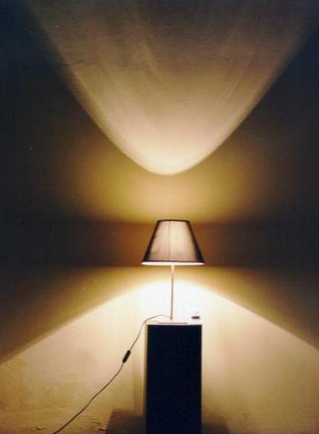
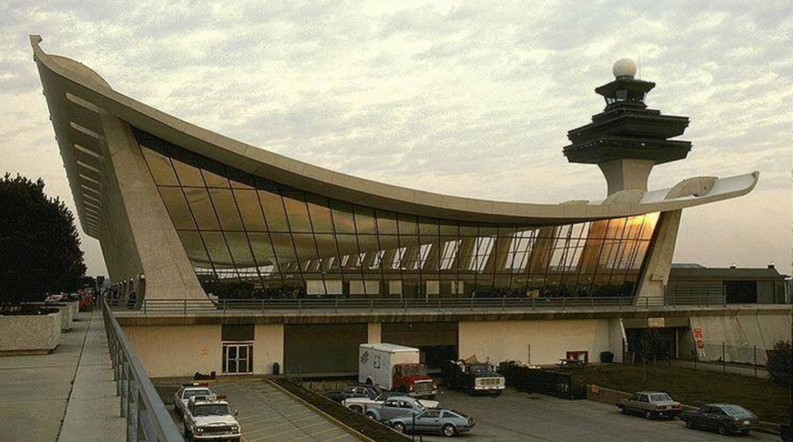
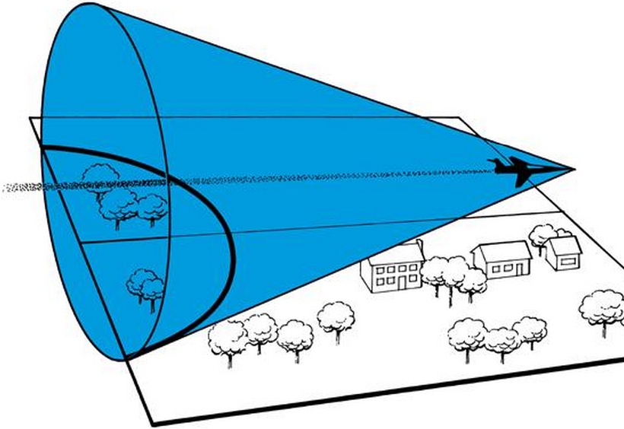
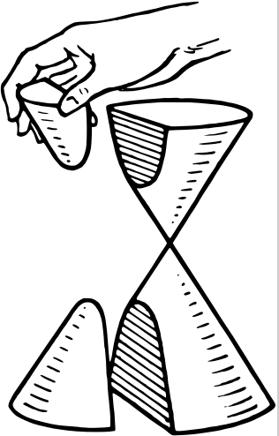
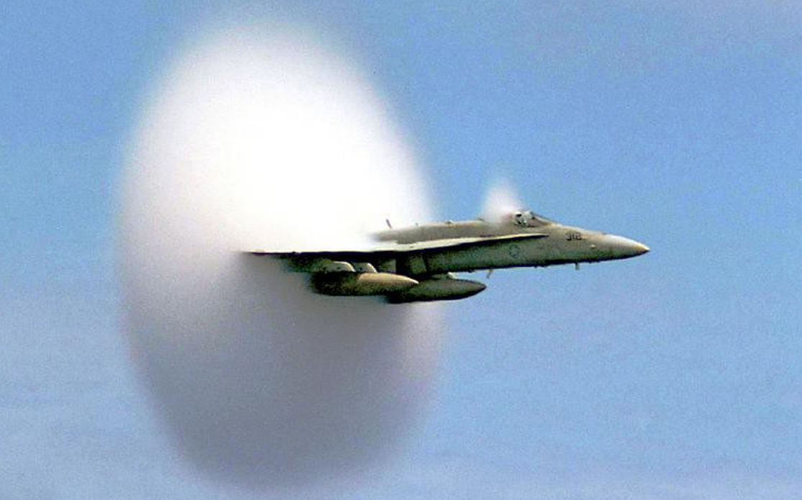
Hyperbolas
In the field of mathematics, a hyperbola is created when you take the intersection of a plane with two halves of a double cone
Applications: architecture,
lighting,
Sonic boom
, cooling nuclear towers

Slide 3
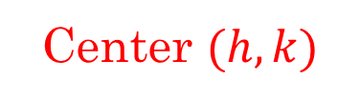
What is a Hyperbola:
The hyperbola is a locus of all points where their difference in distance from each foci is a fixed constant
Horizontal Hyperbola
Center $(h,k)$
Vertical Hyperbola
Suppose you have a point on the hyperbola. The distance from F1 is the blue line and the distance from F2 is he red line
Pick another point and find the distance between each foci
General Form:
The difference in distance between the blue and red line is equal to the difference between the green and purple lines!

Slide 4
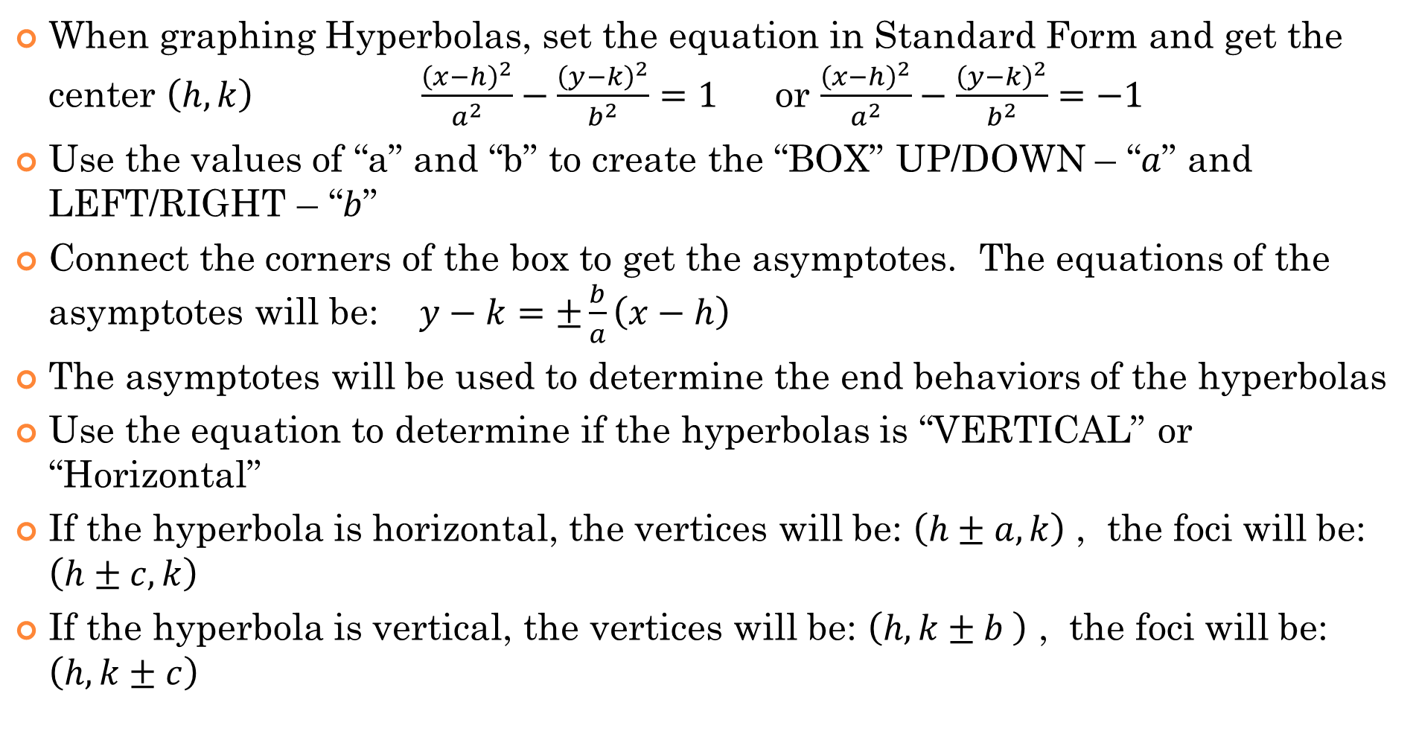
How to Graph Hyperbolas:
When graphing Hyperbolas, set the equation in Standard Form and get the center $\left(h,k\right)$ $\frac{{\left(x−h\right)}^{2}}{a^{2}}−\frac{{\left(y−k\right)}^{2}}{b^{2}}=1$ or $\frac{{\left(x−h\right)}^{2}}{a^{2}}−\frac{{\left(y−k\right)}^{2}}{b^{2}}=−1$
Use the values of “a” and “b” to create the “BOX” UP/DOWN – “$a$” and LEFT/RIGHT – “$b$”
Connect the corners of the box to get the asymptotes. The equations of the asymptotes will be: $y−k=±\frac{b}{a}\left(x−h\right)$
The asymptotes will be used to determine the end behaviors of the hyperbolas
Use the equation to determine if the hyperbolas is “VERTICAL” or “Horizontal”
If the hyperbola is horizontal, the vertices will be: $\left(h±a,k\right)$ , the foci will be: $\left(h±c,k\right)$
If the hyperbola is vertical, the vertices will be: $\left(h, k±b \right)$ , the foci will be: $\left(h, k±c\right)$

Slide 5
Components of a Hyperbola
Note: The transverse axis is the distance between the TWO vertices. NOT the longest of the two “a” and “b”.

Slide 6
HOW to TELL if a Hyperbola is Horizontal or Vertical From Equation:
BEST way to tell if a hyperbola is “vertical” or “horizontal” is by looking at the equation in standard form and then solving for the vertices if either $(x−h) or (y−k)$ is equal to zero
Suppose this is my equation: $\frac{{\left(x−3\right)}^{2}}{2^{2}}−\frac{{\left(y−4\right)}^{2}}{5^{2}}=1$
Suppose we let $(x−3)$equal to zero, we would be solving this equation:
To solve this equation, we need to square root both sides. However, one side is negative, so we can’t square root. Therefore, this CAN NOT be a vertical hyperbola!!
NOW Suppose we let $(y−4)$equal to zero, we would be solving this equation:
To solve this equation, we also need to square root both sides. Since, both sides are positive, we can square root it. This means this will give us two horizontal roots. So this is a HORIZONTAL Asymptote!!

Slide 7
Practice: indicate whether if each of the following hyperbolas are vertical or horizontal

Slide 8
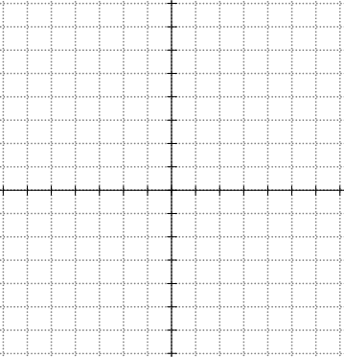
Graph
Find the equation of the asymptotes, length of transverse axis, domain, and range:

Slide 9
Practice: Given each equation, find the center of the hyperbola, length of the transverse, equation of asymptotes, coordinates of the vertices and foci, and the domain and range. Graph each equation:

Slide 10
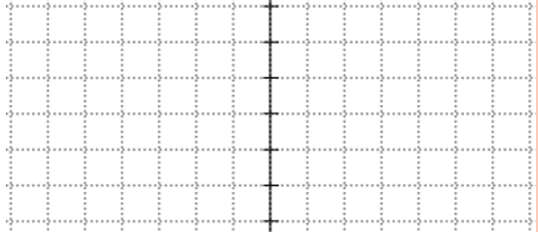
The first step is to convert equation into standard form by completing the square:

Slide 11
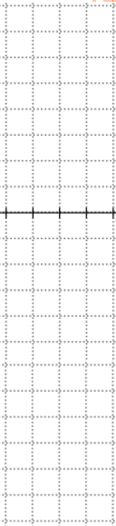

Slide 13
This is a reciprocal function and it is also a hyperbola. However, it is a SLANTED hyperbola. Start by finding both the horizontal and vertical asymptotes
ASYMPTOTES:
A rough sketch of this hyperbola would look like this:
We also know that this graph is symmetrical about the line $y=x$
TO find the coordinates of the vertices, we make the two equations equal!!
The coordinates of the vertices will then be:

Slide 14
This is also a reciprocal function and can be perceived as a slanted hyperbola
First find the vertical and horizontal asymptotes
This hyperbola should be symmetrical over the line: $y=x+1$
TO find the coordinates of the vertices, solve these two equations:

Slide 15
Equations of Hyperbolas:
If we change the ‘+’ sign in an ellipse to a ‘-ve’ sign, we would get a hyperbola

